Slide 1



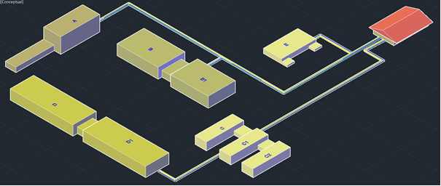
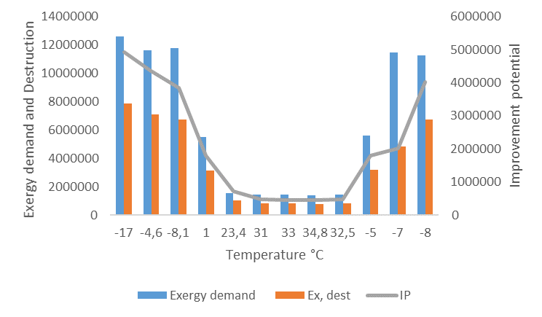
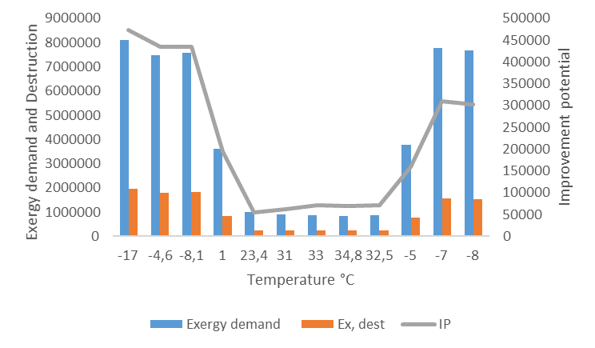
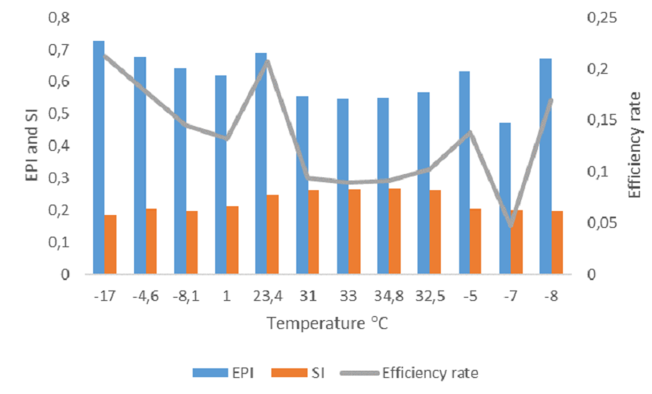
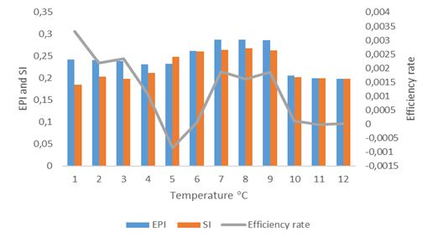


14th International Exergy, Energy and Environment Symposium, December, 24-27, 2023, İstanbul/Türkiye
TITLE
Author | Author | Author
Affiliation and corporate İnformations Mail | Affiliation and corporate İnformations Mail | Affiliation and corporate İnformations Mail
Introduction
In addition to choosing the right system in such large structures with different mechanical system characteristics within the building groups, hydraulic balance problems; can mostly be solved by engineering approaches such as regulating, flow control, or shunt pump applications. In energy consumption controls in systems, mostly local control preferences or applications come to the fore. However, sustainable energy efficiency provides accurate and effective results only if it is done with holistic approaches. In this respect, system selection, operating mode, and parameters should be evaluated, and each selected energy consumption and control element's efficiency should be questioned. Then, depending on the required load, the hydraulic balance should be provided in the entire system for efficient energy use. For this purpose, this study has revealed the importance and management of hydraulic balance in mechanical system control. The study evaluated the effectiveness of hydraulic control and its environmental impact. First, the performance of the hydraulically balanced mechanical system was examined together with the selection of the right approach. In the study, the energy and exergy performance of the system were compared, and the savings potentials were calculated based on environmental sustainability.
Subtitle
Today, developments in building technology and the development of low-carbon technologies have highlighted not only technological preferences but also energy-efficient solutions such as low-carbon and low-temperature heating systems (Da Yan et al., 2015; Özsagiroglu et al., 2022). In reality, classical mechanical systems have a flow structure from the boiler to the heater and are important loss points in the heat energy flow. In these structures, pressure losses can also be expressed as a cause of energy losses besides the possible thermal losses. However, today, with the development of condensation technology, different solutions, such as cascade or redundant operation applications, have developed, especially for hot water systems. These systems, which are operated under pressure, mainly with the help of pumps, are managed together with different control technologies and system flows. While all these have a negative effect on the possible capacity choices in the design, it brings an increase of 525 in capacity and criteria against possible risks. While this situation directly increases the demand effect, it also causes the development of problem areas, such as likely pressure or balance in the systems. In this respect, control costs increase, and additional system solutions, such as balancing valves, are developed for this purpose (Malovrh, 2002).
In such integrated systems with multi-purpose mechanical systems with different heat requirements, hydraulic balance is an essential requirement, and control difficulty in these systems is also the reason for high energy consumption. Regional imbalances produce operational difficulties along with different energy consumption, especially for these systems, where the safety margin is left high in the design and project processes . This directly indicates that there is or may be a pressure problem, flow imbalances due to pressure, lack of system preferences due to demand, inability to provide heat flows due to demand, and control problems in the entire system. The solutions developed for a hydraulic balance problem, especially for the mechanical system, are suggestions such as increasing the operating temperature, increasing the pressure difference and increasing the pump flow rates, developing volumetric control methods in pumps, and expanding the control valves in the pipelines [8]. In reality, such local solutions are intermediate, especially for mechanical systems. However, these are loads placed on the existing system, and these effects also increase energy consumption or operating costs. Instead, as suggested in the study, first of all, the right system choice and demand control should be emphasized. Thus, holistic control management should develop an energy-efficient system solution , by establishing a hydraulic balance depending on the demand, and especially by gaining an operation capability with outside air control.
METHOD
In the system, entropy expresses a potential directly dependent on the dead-state condition. One form of the generated entropy is stated based on the Gouy–Stodola theorem, as given in the below equation(Moran et al., 2011):
In this study, two indices developed for the evaluation of sustainable environmental impact and can be used in engineering solutions, unlike the literature, are discussed. First, EPI (Environmental Performance Index) is directly related to the entropy produced primarily and expresses a function that depends on the ambient temperature of the process. In particular, it can be seen as a parametric value describing the environmental impact of the entropy produced. In this context, EPI;
The sustainability index (SI) developed in this context expresses the environmental sustainability potential of such systems. In this respect, SI;
SI can be defined as an environmental impact limit for all fossil-burning systems (Sogut, 2021). However, boundary conditions for real systems should be seen as something other than an achievable goal.
Figure 1. Mechanical system layout diagram
Heating and hot water needs in the campus are distributed through the pipelines seen in the plan as steam energy carriers. The mechanical system, which has a system infrastructure of about 34 years, mostly has a manually controlled structure. In the five blocks campus, the mechanical system consists of a central boiler center and heat exchanger rooms under each block. The system's current structure consists of a 90/70°C hot water system modified with a hot water system, despite the average steam flow of 145 °C. Flow management and hydraulic flow balance were provided in the system depending on the pump revision together with the hot water, and the efficiencies related to this were evaluated in the system
a. Steam b. 90/70 °C
Comparative analyses of entropy production and exergy destruction
a. Steam b. 90/70 °C
Comparative analyses of entropy production and exergy destruction
While the efficiency rate for Steam indicates 13.38 percent on the annual average, this value, taken together with the hydraulic balance, remains below 1% for the 90/70 °C process.
CONCLUSION
This study presents an example of a campus that was considered to examine the energy and environmental sustainability of heat demand. In this context, the energy and environmental performance of the mechanical systems for the structure, which is based on demand management and where hydraulic balance is applied effectively, in the campus, which works with a mechanical steam system, has been examined based on average outdoor temperatures. According to this;
The energy efficiencies for steam and 90/70 °C processes were 44.8% and 80.26%, respectively, while the exergy efficiencies were 42.3% and 75.7%, respectively.
While the average exergy destruction was 3.7 GJ/h for the steam system, this value was found to be 0.96 GJ/h for the 90/70 °C process, and the IP was found to be 57.7% and 24.3% for both methods, respectively.
The entropy production in the system indicates an average 77% reduction in favor of the 90/70 °C system when both processes are compared.
In terms of environmental impact, 90/70 °C process preference indicates a 39.65% more effective potential in EPI value compared to the steam system. In this context, the efficiency rate in steam systems indicates a possibility of 13.38% as an annual target by energy management.
.
References
RESULTS AND DISCUSION
The campuses have a large energy consumption and energy usage diversity. These mostly public structures have regional energy management tools. Campuses, barracks, multi-story high-rise buildings, complexes with many buildings on the map, and commercial buildings with large volumes are residential areas that consume intense energy. The mechanical system layout plan and building distribution of the campus referenced in this study are seen in Figure 1.
Da Yan, William O’Brien, Tianzhen Hong, Xiaohang Feng, H. Burak Gunay, Farhang Tahmasebi, Ardeshir Mahdavi, Occupant behavior modeling for building performance simulation: Current state and future challenges,
Energy and Buildings, Volume 107, 2015, Pages 264-278, ISSN 0378-7788, https://doi.org/10.1016/j.enbuild.2015.08.032.
Ozsagiroglu, S., Camci, M., Taner, T. et al. CFD analyses on the thermal comfort conditions of a cooled room: a case study. J Therm Anal Calorim 147, 2615–2639 (2022). https://doi.org/10.1007/s10973-021-10612-w
Malovrh M., 2002, The Importance of Hydraulıc Balance of Hot Water Heatıng Systems for Effıcıent Energy Use, Civil Engineering Institute ZRMK Dimiceva 12, SI–1000 Ljubljana Slovenia http://www.enef.eu/history/2002/en/pdf/Malovrh_AJ.pdf
Anjun Zhao, Feifei Dong, Xiao Xue, Jiangtao Xi, Yuan Wei, Optimal control for hydraulic balance of secondary network in district heating system under distributed architecture, Energy and Buildings, Volume 290, 2023, 113030, ISSN 0378-7788, https://doi.org/10.1016/j.enbu ild.2023.113030.
Moran, M.J., Shapiro, H.N., Boettner, D.D. and Bailey, M.B. (2011) Fundamentals of Engineering Thermodynamics, John Wiley & Sons Inc., Hoboken, NJ, USA
Sogut M. Ziya, New approach for assessment of environmental effects based on entropy optimization of jet engine, Energy, Volume 234, 2021, 121250, ISSN 0360-5442, https://doi.org/10.1016/j.energy.2021.121250.

